Slide 1

PROJECT
TEAM 3
on
Bank Statement Data Extractor

Slide 2
TEAM 3
Aman Prasad Kalwar
Dhinesh Lingesan
Manasa Mallesh

Slide 3
TEAM Contribution
Dhinesh Lingesan worked on UI frontend
Manasa Mallesh worked on API and database
Aman Prasad Kalwar worked on data Analytics

Slide 4
Content
Problem statement
Sequence diagram
Tools requirement
API
Scope of project
Results
Github link

Slide 5
Problem Statement
Bank Statement Data Extractor – Extract data from credit card or bank statements and provide analytic and trends for a customer.
INPUT:CSV File
PROCESS:Extract the CSV file and provide the analytics.
OUTPUT:Analytics graph.

Slide 6
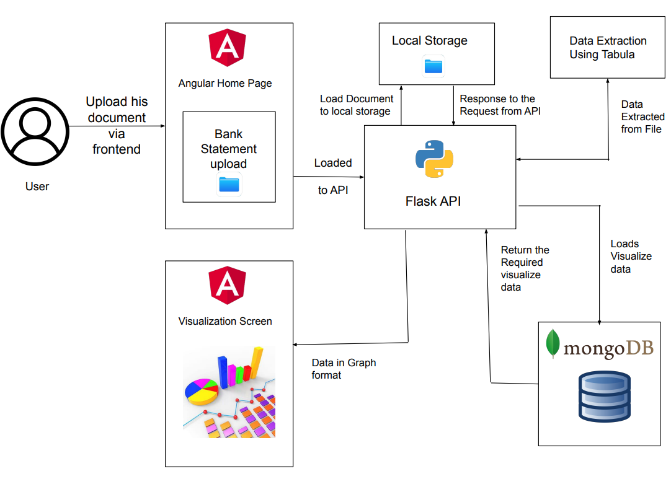
Sequence Diagram

Slide 7
API
File Upload API
Graph API
Date VS Description
Date VS Balance
Debit VS Description
Date VS Debit

Slide 8
Scope of the project
Compare current performance with previous conditions using graph analysis.
Minimise the unwanted expenditure.
Track of savings and expenditure.
Controlling and operating within the budget and in alignment with strategy.

Slide 9
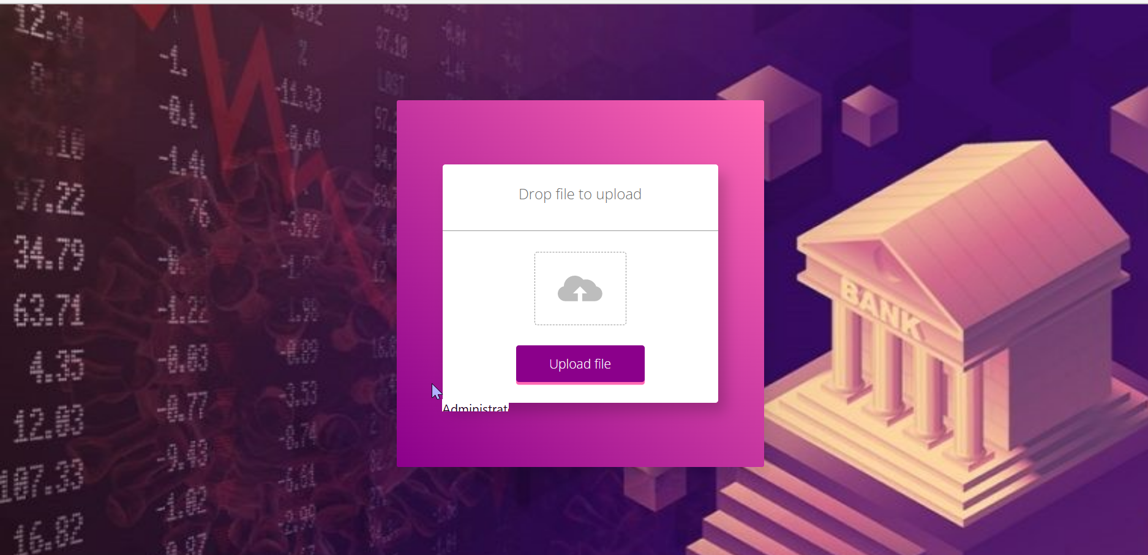
Results
Fig2.snapshot of home page

Slide 10
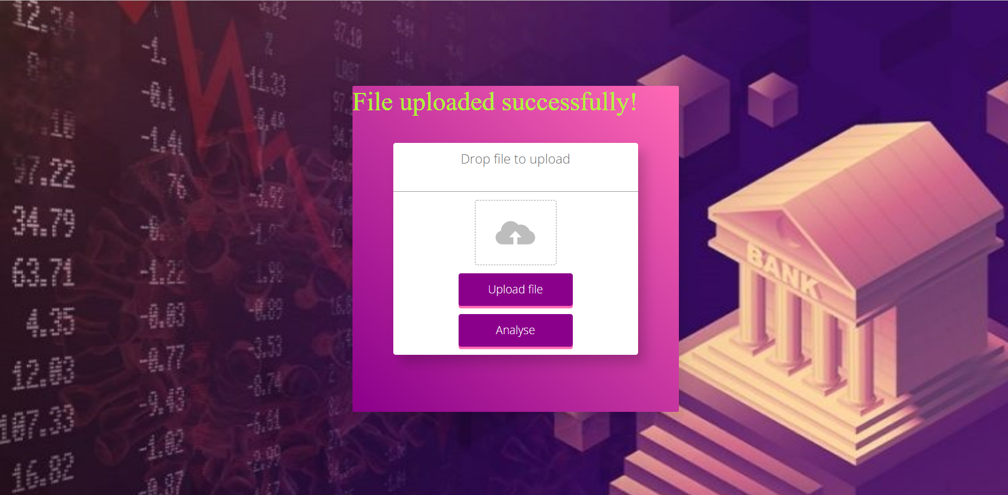
Results
Fig3.snapshot of upload page

Slide 11
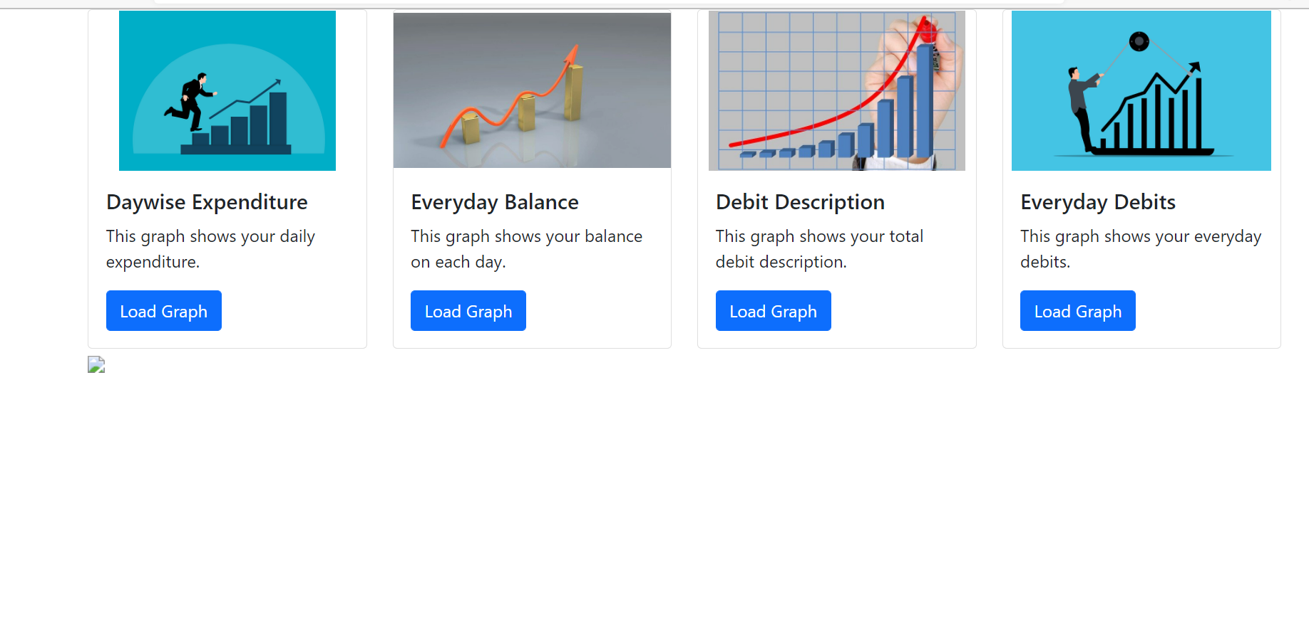
Results
Fig3.snapshot of graph result page

Slide 12
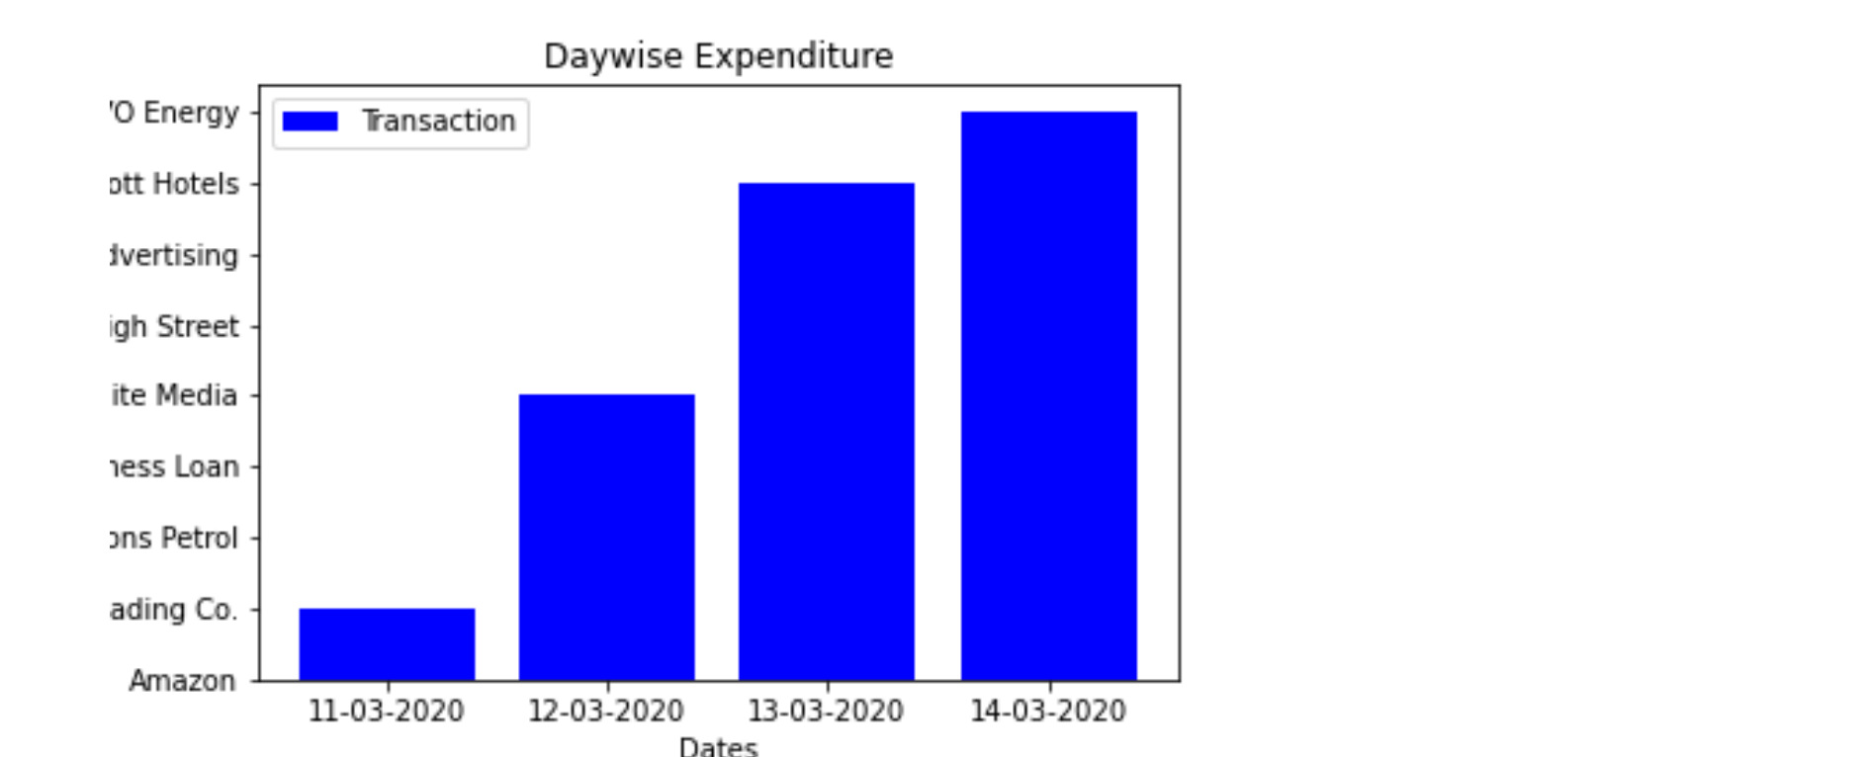
Results
Fig4.snapshot of graph1

Slide 13

Results
Fig5.snapshot of graph2

Slide 14

Results
Fig5.snapshot of graph 3

Slide 15
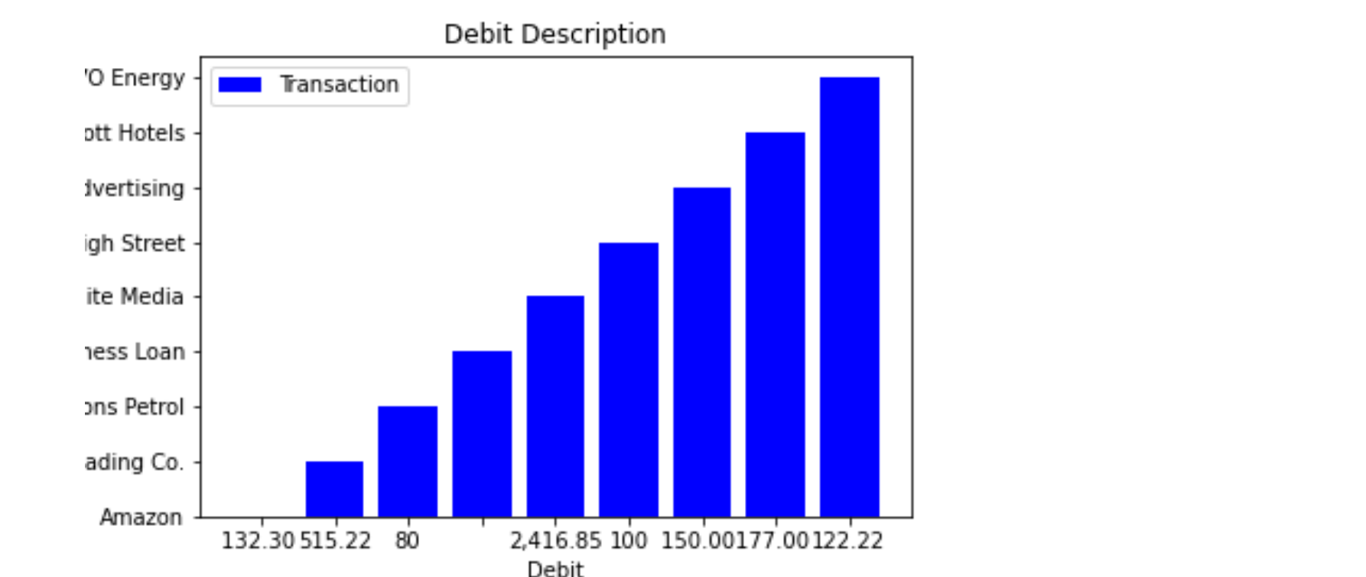
Results
Fig6.snapshot of graph4

Slide 16
THANK YOU!:)

